Slide 1



VISVESVARAYA TECHNOLOGICAL UNIVERSITY,BELGAVI
Project Phase-2 Presentation
ON
“SMART SAFETY DEVICE FOR SEWAGE WORKERS”
Presented by
Faiza shareef Nigah Rehem Shaik S A Sajjad Ahmed
Saad Adam Bandady
4BP19CS015
4BP19CS048
4BP19CS052
4BP19CS053
UNDER THE GUIDANCE OF :
Prof. Umaira Dept. of CSE
Bearys Institute of Technology
Mangalore-574199
PROJECT COORDINATOR :
Prof. Akshata S A Dept. of CSE
Bearys Institute of Technology
Mangalore-574199
Dept of CSE
1

Slide 2
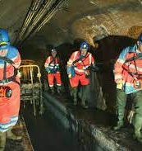
“SMART SAFETY DEVICE FOR SEWAGE WORKERS”
Dept of CSE
2

Slide 3




Meet our team
Nigah Rehem Shaik
Saad Adam Bandady
4BP19CS048
4BP19CS053
Faiza Shareef
S A Sajjad Ahmed
4BP19CS015
4BP19CS052
Dept of CSE
3

Slide 4

ACHIEVEMENT

Slide 5
TABLE OF CONTENTS
1.Introduction
2. Literature Survey
3. Problem Statement
4. Objective And
Methodology
5. Implementation
6. Conclusion
Dept of CSE
5

Slide 6
INRODUCTION
The term Internet of Things, refers to the collective network of connected devices and the technology that facilitates communication between devices and the cloud, as well as between the devices themselves.
This project aims to design a system to measure and analyze the real-time levels of toxic gases and alert the workers.
This project attempts to device an IOT technology that shall detect the mixture of gases, sensing each type of gas to measure its level while keeping track of the real-time dynamic changes in the above factors.
In this project, a wearable smart safety device for sewage workers is proposed which intends to safeguard their life by providing early notifications for the presence of toxic gases.
Dept of CSE
6

Slide 7
LITERATURE SURVEY
Title | Description | Limitation
M. Maroti, B. Kusy, G. Simon, and A. Ledeczi, “The flooding time synchronization protocol,” in Proc. ACM SenSys’04, Baltimore, MD | The smart drainage system will have: Sensors to detect blockage, flood and gases. The intelligence of sensors and system will identify the clogging inside the drainage system and will give the details of the location and other information for further actions. | - Sometimes Fails to alert higher authorities.
“Smart Safety Monitoring System for Sewage Workers with Two Way Communication” Sudhanshu Kumar | sewage cleaning is one major concern and a challenge always. This paper thus put forth a new proposed system which is microcontroller based application of sewage workers health monitoring systems using IOT | - Expensive
Dept of CSE
7

Slide 8
LITERATURE SURVEY
Title | Description | Limitation
“Iot based smart safety monitoring system for underground sanitation workers” Hebziba Jeba Rani S, Yamini C L, Sakthivel M, Surendar S | It attempts to develop an IoT based smart safety monitoring system for underground sanitation workers that detects the toxic gases released during underground sewage cleaning process and a system to monitor the health of the underground sanitation workers. This system senses the type of toxic gas along with its severity level | - The device is kept at a particular place to detect toxic gases
Dept of CSE
8

Slide 9

PROBLEM STATEMENT
The sewage workers have to clean the impurities releasing from the communities, impurities dumped by the municipality and the industrial waste which is highly toxic.
So the sewage workers lives are always at risk.
A Smart Safety Monitoring System is developed that detect the condition of the worker, harmful gases inside the manhole and flood so that when the values exceed the threshold values, buzzer is activated automatically and messages are sent to the headquarters .
Dept of CSE

Slide 10
OBJECTIVE
To provide safety for sewage workers
To avoid deaths of sewage workers due to toxic gasses.
To update the readings in display.
To alert the worker if any parameters exceed.
As soon as parameters exceeds, it updates the values in Thngspeak.
Dept of CSE
10

Slide 11
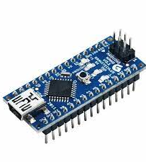

METHEDOLOGY
Hardware Components
1. Arduino Nano
The Arduino Nano is a compact and versatile microcontroller board, based on the ATmega328P microcontroller
small size, measuring just 45mm x 18mm
ATmega328P microcontroller, which runs at a clock speed of 16 MHz It has 32KB of flash memory for storing the program code and 2KB of SRAM for data storage
Dept of CSE
11

Slide 12
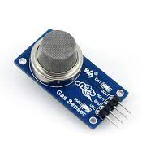
2. MQ2 Gas Sensor
It is a sensor belonging to the MQ series which is capable of detecting carbon monoxide(CO), Methane(Ch4), and flammable gases.
Sewage workers are often exposed to these gases hence this sensor can be used to keep a check on gas levels.
.
Dept of CSE
12

Slide 13
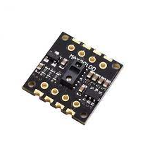
3. MAX30100 PULSE OXIMETER
The MAX30100 is an integrated pulse oximetry and heartrate monitor sensor solution.
combines two LEDs, a photodetector, signal processing to detect pulse oximetry and heart-rate signals
The MAX30100 has an on-chip temperature sensor
The SpO2 subsystem in the MAX30100 is composed of ambient light cancellation
operates from 1.8V and 3.3V power supplies.
Dept of CSE
13

Slide 14
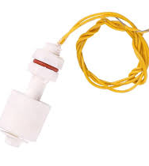
4. WATER LEVEL SENSOR
The sensor has ten exposed copper traces.
The more water the sensor is immersed in, the better the conductivity and the lower the resistance
The sensor generates an output voltage proportional to the resistance; by measuring this voltage, the water level can be determined
Dept of CSE
14

Slide 15
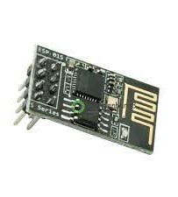
5.WIFI MODULE
A Wi-Fi module, also known as a Wi-Fi chip or Wi-Fi module, is an essential component that enables devices to connect wirelessly to local area networks (LANs) and the internet
This involves connecting the RX (receive) and TX (transmit) pins of the ESP8266 module to the corresponding pins on the Arduino Nano, allowing them to exchange data.
Dept of CSE
15

Slide 16
REQUIREMENTS
Software requirements | Hardware requirements
Arduino IDE ThingSpeak | Arduino Nano Wifi Module Buzzer Gas Sensor Power Supply Pulse Sensor Lcd Display Water Level Sensor
Dept of CSE
16

Slide 17
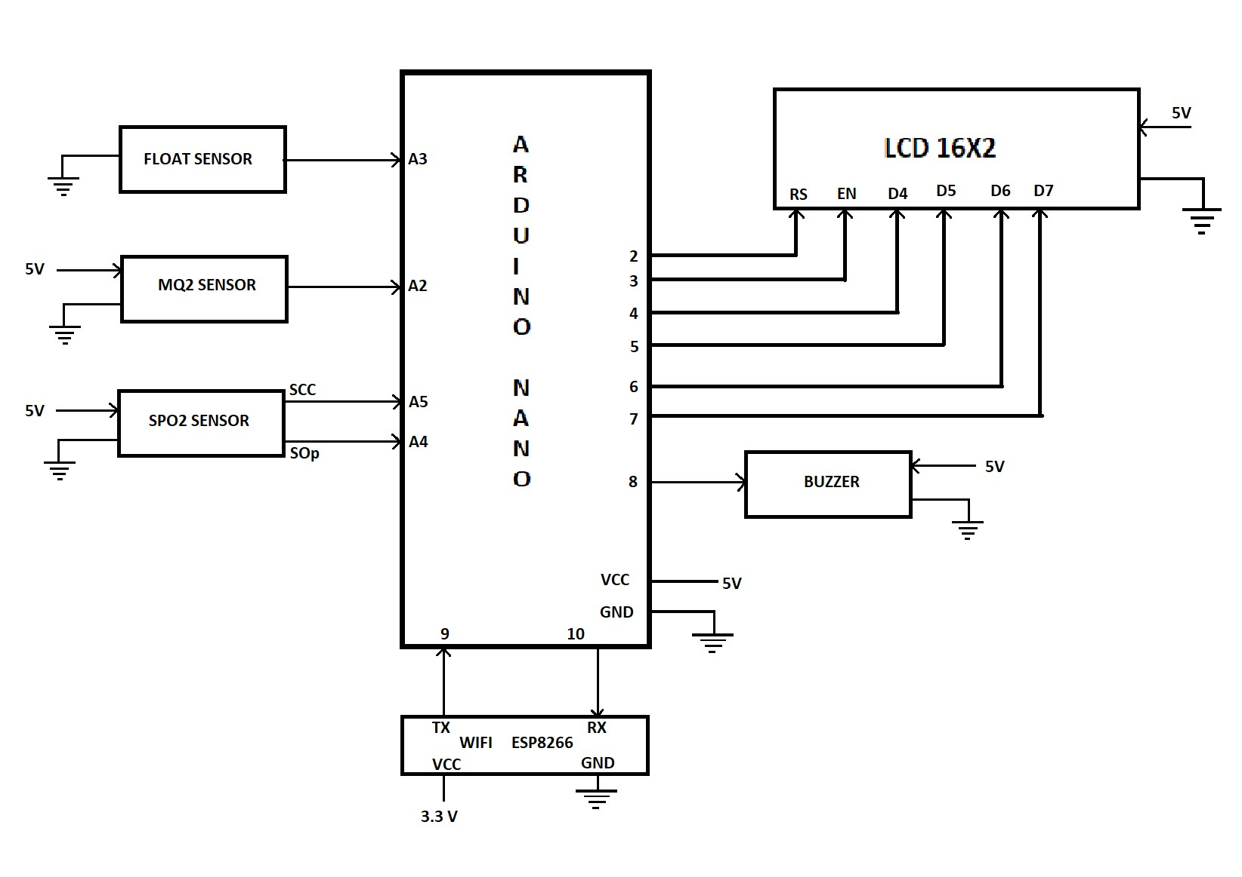
IMPLEMENTATION
Fig 1 : Hardware Design
Dept of CSE
17

Slide 18
SOFTWARE IMPLEMENTATION
ARDUINO IDE INSTALLATION
ARDUINO IDE SETUP
THINGSPEAK INSTALLATION AND SETUP
Dept of CSE
18

Slide 19
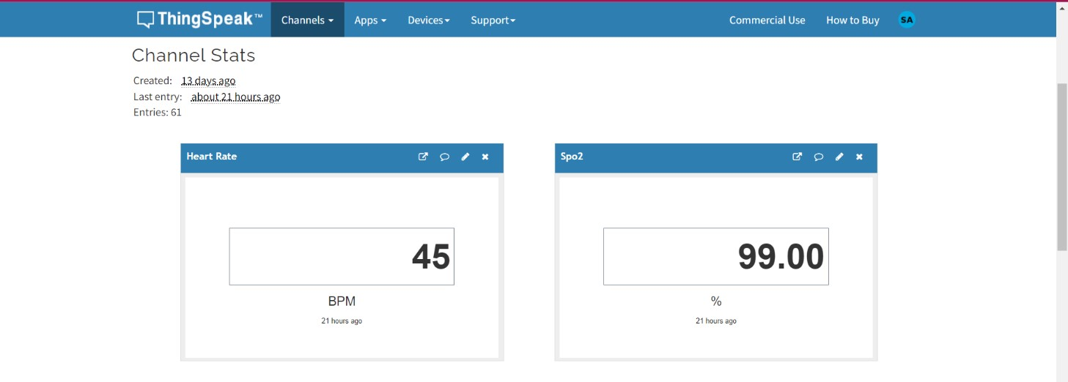
UPDATES AT THINKSPEAK
Fig 2 : Heart rate and SPO2 sensor values at updated ThingSpeak
Dept of CSE
19

Slide 20
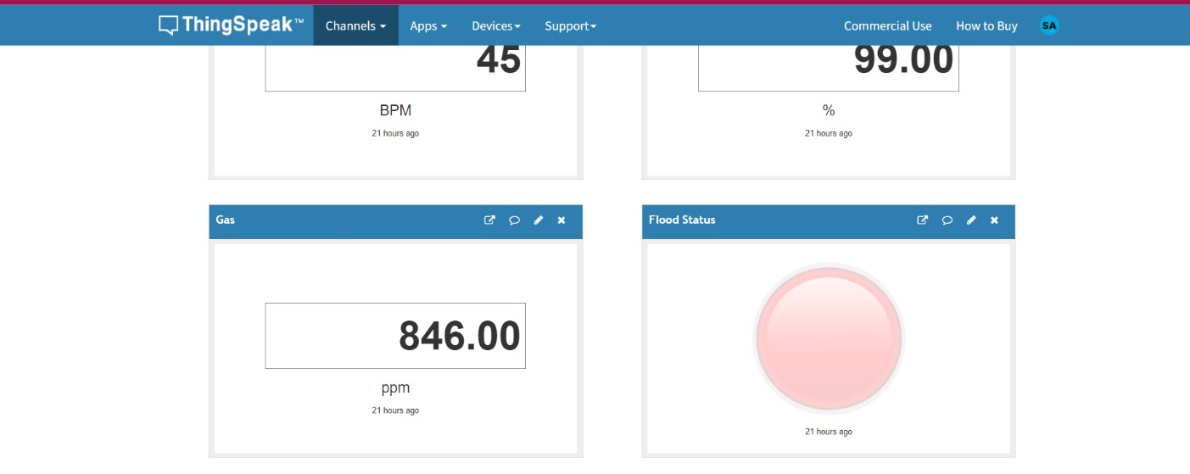
UPDATES AT THINKSPEAK
Fig 3 :Gas sensor value and flood status at updated ThingSpeak
Dept of CSE
20

Slide 21
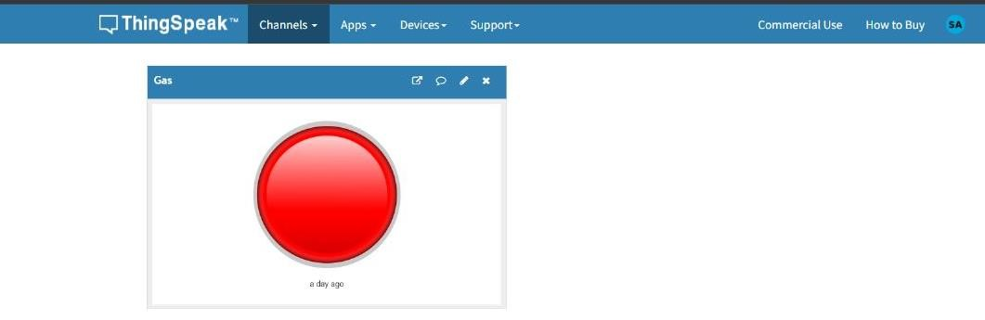
UPDATES AT THINKSPEAK
Fig 4 :Gas sensor status at updated ThingSpeak (in danger)
Dept of CSE
21

Slide 22
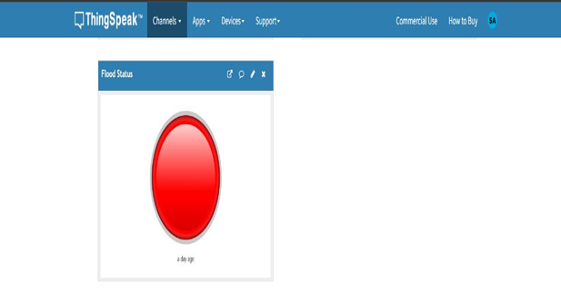
UPDATES AT THINKSPEAK
Fig 5 : Flood status at ThingSpeak (in danger)
Dept of CSE
22

Slide 23
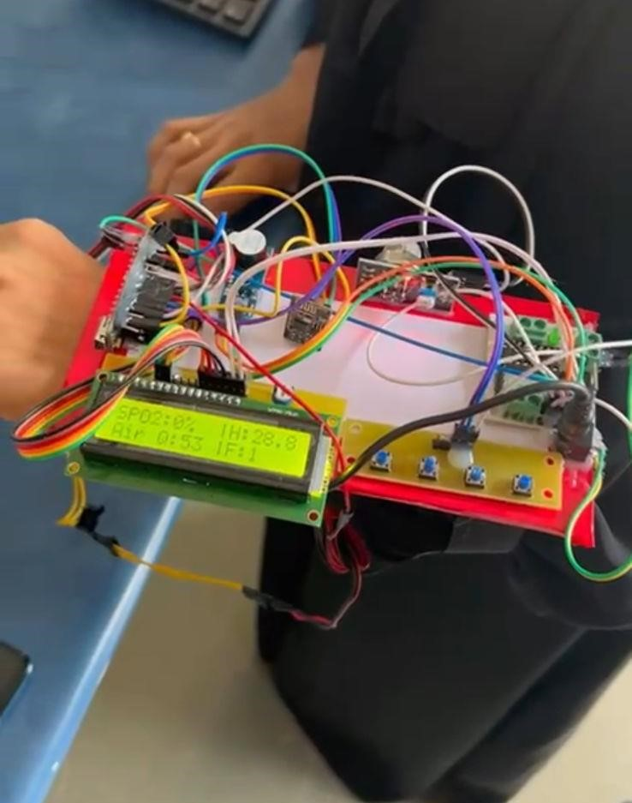
HARDWARE DEMONSTARTION
Dept of CSE
23

Slide 24
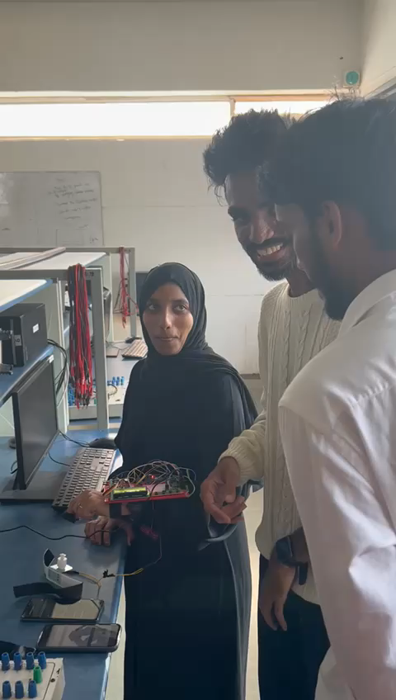
HARDWARE DEMONSTARTION
Dept of CSE
24

Slide 25
CONCLUSION
This device is designed keeping in mind, the measurement of necessary parameters, which needs to be monitored for unhindered safety of the workers.
The device finds major application in household sewage systems, municipal manholes and sewage, sewer, deep well, gutters and drains etc.
This project is the next big step in the direction of safety. With some small and simple efforts, it
can deal with the greatest challenges against safety hazards by using modern technology.
Dept of CSE
25

Slide 26
REFERENCES
M. Maroti, B. Kusy, G. Simon, and A. Ledeczi, “The flooding time synchronization protocol,” in Proc. ACM SenSys’04, Baltimore, MD, November 2004
“Smart Safety Monitoring System for Sewage Workers with Two Way Communication” Sudhanshu Kumar in 2003
“Iot based smart safety monitoring system for underground sanitation workers” Hebziba Jeba Rani S,
Yamini C L, Sakthivel M, Surendar S
Dept of CSE
26

Slide 27
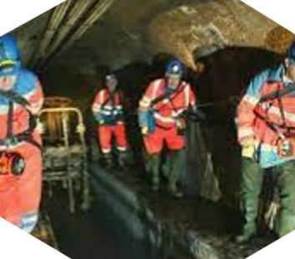
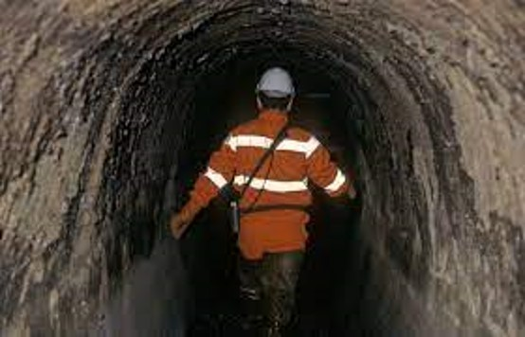
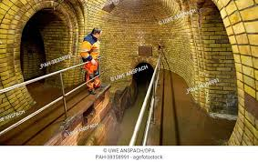
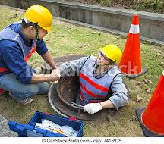
Thank you
☺
Dept of CSE
27

